Slide 1
TU Graz “Micro-Credential” in Sustainable Building Design
https://www.tugraz.at/en/institutes/ibpsc/teaching/courses/master

Slide 2

S-LAB (Project 383) will create a new “micro-credential” in “Sustainable Building Design”
By completing a microcredential, participants gain specific knowledge, skills and competencies that meet current labour market needs. Micro-credentials can be completed before, during and after a university degree, or independently of it.
ECTS credit points: 1-9
Duration: multiple days up to 1 semester
Longer options (10-29 ECTS) are also possible leading to a Certificate of Advanced Studies (CAS)

Slide 3
IBPSC Master Modules
1. Low Carbon Building Design and Communities
2. Energy Monitoring and Effects on Indoor Climate
3. Building Performance Simulation
= micro-credential” in “Sustainable Building Design”

Slide 4
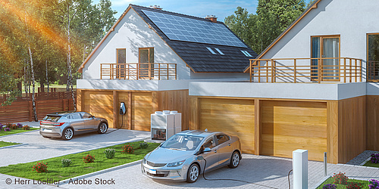
1. Low Carbon Building Design and Communities
Semester Hour: 2
Type: Lecture and Workshop
Low carbon buildings and communities will play a crucial role in future building design and construction. This module covers core topics to address this challenge, including climate change and the built environment, high-performance building assessment (e.g., Passivhaus), it also addresses low carbon technologies, carbon accounting methods, steady-state energy modelling, the circular economy, and international environmental assessment methods (e.g., LEED, BREEAM, Klimaaktiv).
Objectives: Students gain a deeper understanding of how climate, people, equipment, building design, and material selection impact energy consumption, carbon emissions, air pollution, biodiversity, resource use, and waste. Several tools are intorduced including SketchUp, designPH, PHPP and others.

Slide 5

2. Energy Monitoring & Effects on Indoor Climate
Semester Hour: 2
Type: Lecture and Workshop
The module introduces measurement concepts and technical solutions for energy monitoring for the assessment of indoor environmental quality (IEQ). Students learn how to record thermal and energetic properties of the building envelope, technical building equipment, and collect data on user behaviour and climate. A key focus of the course is data management, essential for understanding building performance (manage, store, retrieve, and evaluate the resulting data).
Objectives: Students will develop techniques to record and assess the thermal and energetic properties of buildings by learning important data processing skills (manage, store, analyse, interpret and present data) using the open-source programming language “R”.

Slide 6

3. Building Performance Simulation
Semester Hour: 2
Type: Lecture and Workshop
The module covers climatic and weather data, heat transfer processes (conduction, convection, radiation) in building simulation, and the impact of solar radiation on glazing and window modelling. Students learn to model and simulate a reference building and apply model validation and calibration techniques, with a focus on data sources and quality assurance.
Objectives: Students will have a deeper understanding of dynamic building performance simulation including the issues of physical, design and modelling uncertainties. The software predominantly used on this module is the dynamic simulation tool IDA-ICE.

